Slide 1
Institutional Internal Audit Information System
BY: ‘AIN NABILAH BINTI AZMAN

Slide 2
Introduction
This “Evaluation instrument for Institutional Audit” is specifically directed for purposes of institutional audit.
The instrument is designed to measure the level of quality in such a flexible way that it can incorporate various types of quality audit.

Slide 3
Objectives
To identify the requirements for the information system based on the needs of the institutional internal audit
To design presentation layer, business layer (calculation, store and keep) and data layer (database) for the information system (3-tier architecture)
To develop an information system that can capture, calculate, integrate and generate an audit data and results
To conduct test and deploy the information system

Slide 4
Problem statement
Currently, university is using individual spreadsheet files to capture and analyze the data.
On these matters, there are too many errors with regards to the formula for calculation. Plus, it is difficult to integrate past and future reports to have a comprehensive as required by the university.

Slide 5
Scope of the project
Targeted to be used by internal auditors of UniKL
Set up and configure the assessment criteria
Key in assessment input of scores and comments for each of the criteria
Calculate score for assessment criteria according to the formula given.
Allow the users to generate a report in form needed
Having an analysis of data collected in the form of graph

Slide 6
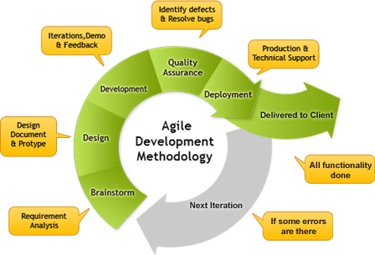
Methodology used in the project

Slide 7
Agile methodology
The project will developed by using agile due to vary reasons;
The locations between stakeholders and developers are very close. So it is easier for developers to schedule and have a meeting to track and show progress to the stakeholders.
In case the stakeholders want to have changes in certain parts, the developers are easy to have a thru communications.
It is easy to handle and conduct a prototype and have a feedback directly from time to time.

Slide 8
Resources
No. | Software | Budgets (RM)
1 | Visual Studio 2013 | 187.25
2 | SQL Server 2014 | 158.15
 | Hardware
3 | ASUS A450L | 2 100.00
4 | Printer Canon E510 | 270.00
5 | Transcend StoreJet 25H3 (USB 3.0) | 230.00
 | Others
6 | Paper | 36.00
7 | Ink | 50.00
 | Total Cost | 3 031.40

Slide 9
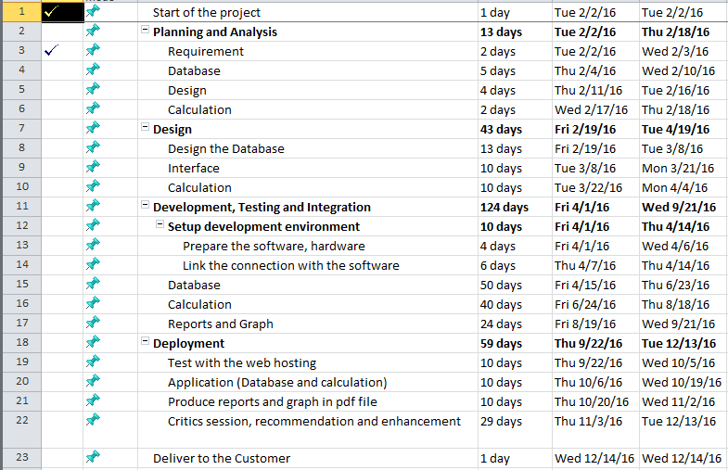
Proposed schedule

Slide 10
Expected outcomes
The system target to be used by internal auditors of UniKL
The system be able to set up and configure the assessment criteria
This project be able to key in assessment input of scores and comments for each of the criteria
The system can calculate score for assessment criteria according to the formula given.
This project allow the users to generate a report in form needed
This project able to do an analysis of data collected in the form of graph

Slide 11
Potential for commercialization
Yes, because this is going to be used by the auditors in UniKL after the project completed. The system also believed can be sell and adapt to any institutional environment besides UniKL MIIT itself, since the criteria and formula of the system can be changed according to their guidelines.

Slide 12
Conclusion
When the system is completed, this will become a huge benefit to the auditors and the head of auditors themselves, since they can overcome the problems that they are facing all this while.

